Slide 1
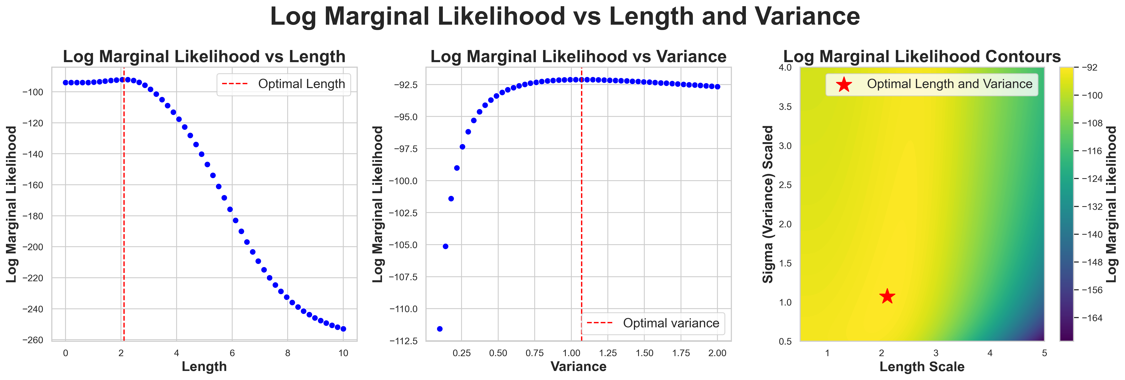
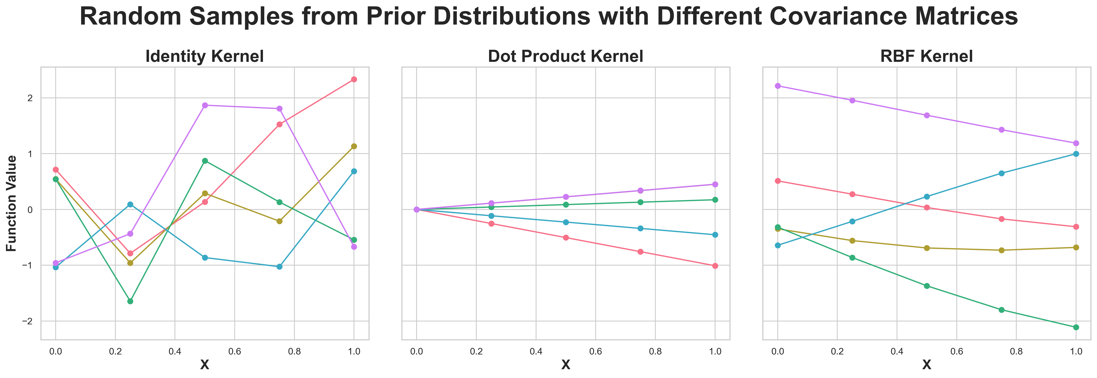
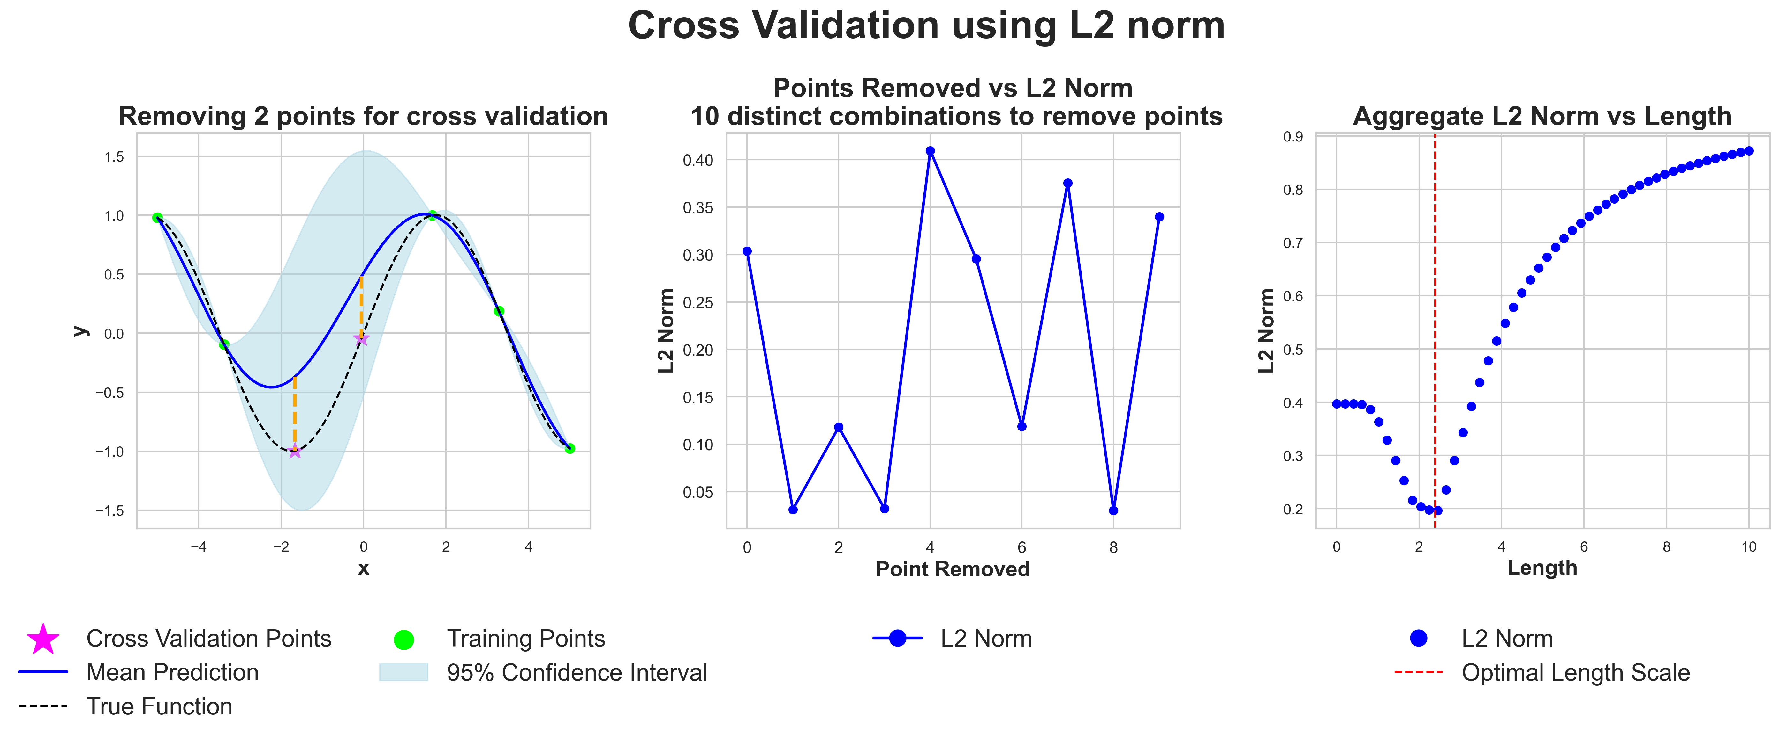
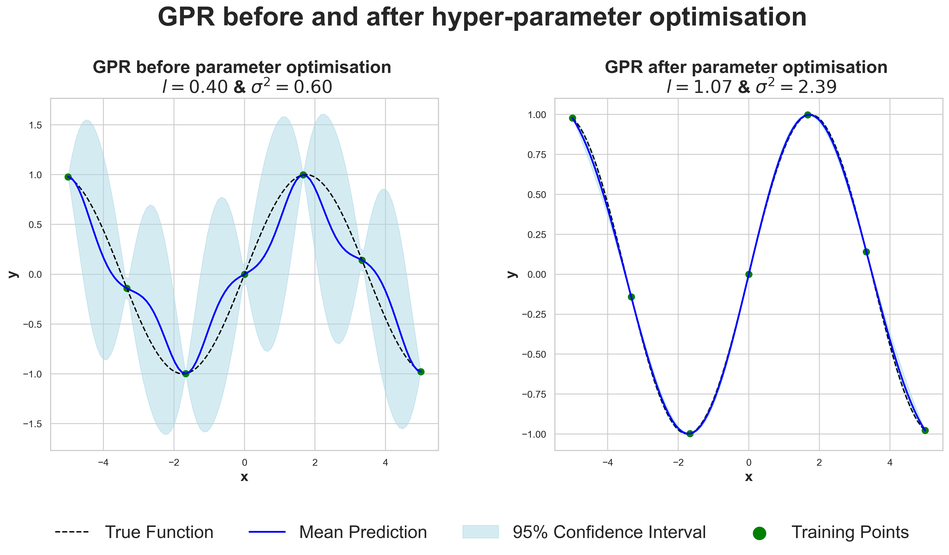
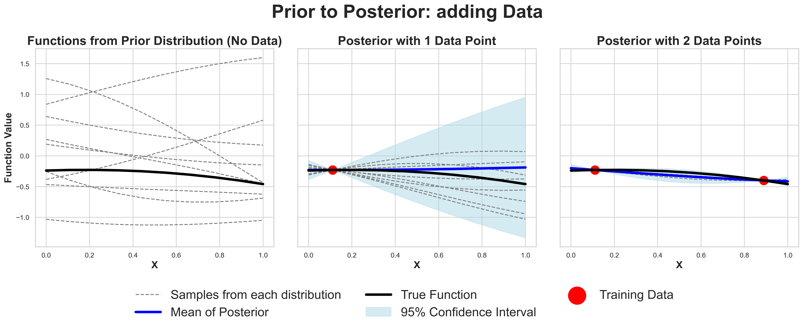
Title goes here (pt. 88)
Author, Author & Author (pt. 54)
Department, University (pt. 54)
Introduction (pt. 60)
Parameter Optimisation
accuracy of their ca
GPR for Gravitational Waves
Briefly introduce your topic.^{1,2,3} (pt. 44)
Log Likelihood
Emphasize the goal of the study.
The prior distribution and the role of the kerne
L2 norm and Cross Validation
Gravitational Wave Data
Next Steps:
Prior to Posterior
Summarize your results & talk about the big picture.
Before vs After
References
Lastname, F. (2000). Title of article. Journal., Volume, page-page.
Lastname, F. (2000). Title of article. Journal., Volume, page-page.
Lastname, F. (2000). Title of article. Journal., Volume, page-page.
Logo 2
email@university.edu
Notes:
Behavioral results: make bar graphs of RT?
fMRI results: labels, figure caption, make blues in graph the same color
References: add marcel 2004, add numbers, rearrange

